Slide 1

Western Illinois University:
Information and activity adapted by the University of Maryland Extension and University of Delaware's Smart Choice Health Insurance Workbook.
F.Y.I: First-Year Insured
Presented By:
Health Insurance Coordinator, Health Education Graduate Assistant, Medical Professional
Notes:
Option 1 - Cover photo

Slide 2


Presentation Outline
Instroductions
Today's Topics
Why is health insurance important?
What do these terms mean?
Basic Coverage of WIU Health Insurance
Small Group Activity
Discussion

Slide 3

Have you ever...
had to go to the doctors and be asked about your insurance information?
heard of the terms PPO or HMO, yet have no idea what they mean?
had to call your insurance company, but have no idea what number to call?
HEALTH INSURANCE

Slide 4





What does it mean to have Health Insurance?
Having health insurance provides you coverage for not just your medical expenses, but much more.
VISION
DENTAL
MEDICATION
BEHAVIORAL HEALTH
REHABILITATION SERVICES

Slide 5

NEXT
Terminology
NETWORK
ESSENTAIL HEALTH BENEFITS
REFERRAL
PREAUTHORIZATION
ALLOWED AMOUNT
Groups your health insurance or plan has a contract with to provide services. Anyone who is apart of the group is considered "in-network". Those whoa re not in the group are considered "out-of-network" and have limited benefits.
Must include items and services within at least these 10 categories; Emergency services, ambulatory services, hospitalization, maternity, mental health, rehab services/devices, prescription drugs, laboratory services, preventive and wellness services, pediatric, oral and vision
A written order from your primary care doctor for you to go see a specialist or to get certain medical services. Some plans require referrals for coverage. If your plan does and you were to not get a referral, there is a chance it will not be covered.
A decision made by your health insurer that health care service, treatment plan, prescription drug, or durable medical equipment is necessary. Certain plans require preauthorization for certain services before you receive them.
The maximum dollar amount on which insurance payment is based for covered health care products and services. This may also be called "eligible expenses", "Payment allowance" or "negotiated rate". If your provider charges more than the allowed amount, you may have to pay the difference.

Slide 6

The amount you owe for health care services you health insurance or plan covers before your health insurance or plan begins to pay.
Ex. you have 500 deductible, you will pay 500 before the insurance will begin to pay anything.
Your expenes for medical care that aren't reimbursed by insurance. Out-of-pocket costs include deductibles, coinsurance, and co-paymenfor covered services plus costs for services that aren't covered by insurance.
Your part of the costs of a covered health care service. This is a part of the allowed amount for the service. You may pay this amount once you have met your deductible.
The amount that must be paid for your health insurance plan. Premiums may be shared between you and your employer
A fixed amount you pay for a covered health service, usually when you get the service. You may have to meet our dedutible first.
PREMIUM
CO-INSURANCE
DEDUCTIBLE
CO-PAYMENT
OUT-OF-POCKET
NEXT
Terminology Cont.

Slide 7
Types of Health Insurance
HMO (Health Maintenance Organization)
PPO (Preferred Provider Organization
A plan that only covers care from doctors who are a part of the HMO. It generally will not cover out-of-network care unless it's an emergency. You may have to live or work in a certain area to be covered. Typcailly a referral is needed to see a specialist.
A plan that has a special network or group of healthcare providers. You pay less if you use the providers in the plan's network. You may not need a referral from your primary doctor to see a specialists
EPO (Exclusive Provider Services)
POS (Point of Service)
A plan in which you pay less if you use doctors, hospitals, and other health care providers that belong to the plan's network. You will need to select a primary care provider for regular check-ups and referrals to see a specialist.
A plan that covers services only if you go to doctors, specialists, or hospitals on the plan's approved list (network). You can go to any provider in an emergency.

Slide 8


Example Scenario
Lucky has a PPO insurance plan
The plan includes:
  Basic health insurance
    $250 deductible
    80/20 coinsurance
    $3,000 out-of-pocket
Excludes:
  vision and dental coverage
Lucky's bills for the year:
  annual doctor visits ($150)
  Car accident ($10,000)
How much will Lucky owe? How much will the insurance cover?

Slide 9
Activity Time
You will have 15 mins to complete 5 scenarios with your group. Use the skills you just learned to help answer the questions given.
INSURANCE SCENARIOS

Slide 10

Discussion Questions
Questions One
Which scenario was the hardest to work through?
Question Two
Did other people in your group have a different way of solving the scenario?
Question Three
Did you find it beneficial to work with other students through these scenarios?

Slide 11

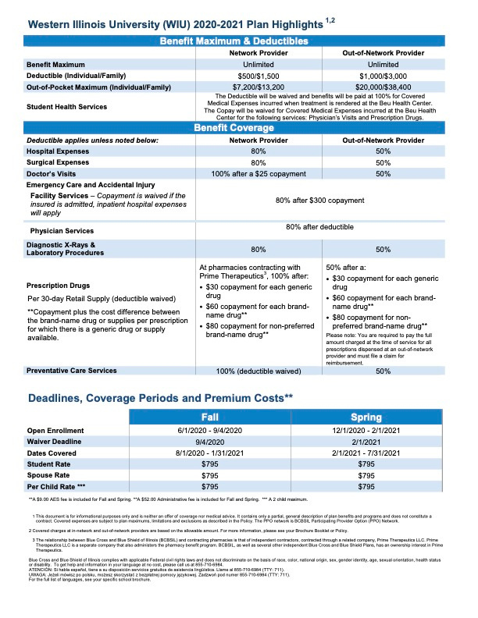

Slide 12

Contact Information
For questions, comments and inquiries
PHONE NUMBER
EMAIL ADDRESS
WEBSITE

